Slide 1
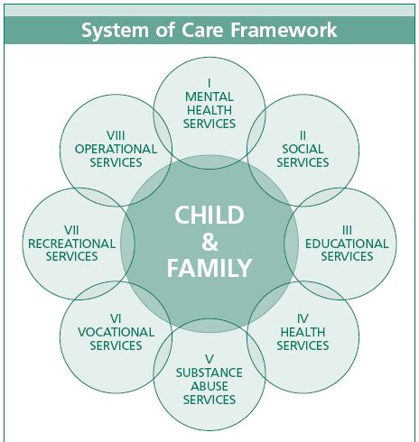
System of Care – A Partnership with Cumberland County Schools

Slide 2
Core Values
Child centered and family focused;
Community-based; and
Culturally and linguistically competent.

Slide 3
Guiding Principles
Comprehensive, incorporating a broad array of services and supports (including informal supports such as mentors, family advocates, relatives, faith community, etc.); use Person-Centered (Essential Lifestyle) Planning
Individualized to the strengths and needs of the child and family and guided by an individualized service plan;
Provided in the least restrictive appropriate settings;
Involving families as full partners in all decisions;
Coordinated at both the administrative and service delivery levels;
Integrated as well as linked and coordinated through a designated care manager; and
Emphasizing early identification and intervention.
Delivers services to all students regardless of race, culture, creed, ethnic background, gender, etc. in ways that optimize culturally responsive service delivery

Slide 4
Why Is SOC So Important?
Research teaches us that SOC is a “best practice” in terms of achieving optimal educational, clinical, social and emotional outcomes in children ….
  Hawkins and Catalano (1995) discovered that risk and protective factors are associated with four general problem behaviors: substance abuse, violence, delinquency, teen pregnancy and school drop-out. These risk and protective factors are organized into the important areas - or domains - of a young person's life: individual/peer; family; school; and community.

Slide 5

School Risk Factors – Specifically
In risk and protective factor theory, successful efforts to prevent emotional and academic maladjustment should do 2 things…reduce risk, and increase protection. The following illustrates what the research teaches us:
Risk Factors (need to reduce) | Early and persistent antisocial behavior • Academic failure beginning in elementary school • Low commitment to school
Protective Factors (need to increase) | Bonding to a school that promotes healthy beliefs and clear standards: Meaningful opportunities to contribute to the school community Skills to successfully take advantage of those opportunities Recognition/ acknowledgement of efforts

Slide 6
What Key Outcomes Occur w/SOC? (1)
Reduced costs due to fewer days in inpatient care. The average reduction in per-child inpatient hospital days from entry into services to 12 months translated into an average per-child cost savings of $2,776.85.
Decreased use of inpatient facilities. The percentage of children who used inpatient facilities within the previous 6 months decreased 54 percent from entry into systems of care to 18 months after systems of care.
Reduced arrest results in per-child cost savings. From entry into systems of care to 12 months after entry, the average reduction in number of arrests per child within the prior 6 months translated into an average per-child cost savings of $784.16.
Mental health improvements sustained. Emotional and behavioral problems were reduced significantly or remained stable for nearly 90 percent of children after 18 months in systems of care.

Slide 7
So What Key Outcomes Occur w/SOC? (2)
Suicide-related behaviors were significantly reduced. The percentage of children and youth who had deliberately harmed themselves or had attempted suicide decreased 32 percent after 12 months in systems of care.
School attendance improved. The percentage of children with regular school attendance (i.e., 75 percent of the time or more) during the previous 6 months increased nearly 10 percent, with 84 percent attending school regularly after 18 months in systems of care.
School achievement improved. The percentage of children with a passing performance (i.e., C or better) during the previous 6 months increased 21 percent, with 75 percent of children passing after 18 months in systems of care.
Significant reductions in juvenile detention. Children and youth who were placed in juvenile detention or other secure facilities within the previous 6 months decreased 43 percent from entry into services to 18 months after entering systems of care.
(Data on this and the previous slide are from a SAMHSA study of its national 2005 Comprehensive Community Mental Health Program)

Slide 8
How Can We, Together, Do SOC?
SOC is a community effort, not a mental health, DSS, juvenile justice or other single agency initiative
In order for SOC to work well, everyone has to shed their single agency thinking and coalesce around families and students
Folks around the table are willing to do some things differently toward piloting a true SOC effort in your school attendance area – including innovative use of personnel and funding

Slide 9
How Can We, Together, Do SOC? -2
For example:
  Glenda Best, the SOC Coordinator from CCMHC, is committed to on-site Child and Family Team coordination and case tracking
  DSS has the ability to geographically assign case workers to your individual schools and meet on site with your staff and families of students
  Juvenile Court Counselors already assign their staff by school location

Slide 10
Example
Student “A” has serious attendance problems, school staff cannot engage the parent(s), grades are failing and teachers have noticed that she is associating with very negative peers when in school. She often keeps her head down on her desk, questions arise as to: depression, drug/alcohol use, poor parental control and monitoring, history of trauma, possible learning disabilities or other cognitive problems, etc.
  Teacher (or anyone) can refer the youth to a student assistance team trained in, or aware of the SOC resources. They call in Glenda, who works with school staff to plan what needs to be done – testing/assessments, gathering of records and arranging of home visits with family to assess that environment, convening of Child and Family Team to plan what needs to be done by whom, where and when? NOTE that Glenda is not the school social worker – but the C & F Team facilitator and case tracking specialist who ensures that the process is followed and that the data are collected. Glenda works with the school social worker(s), guidance, etc. and all resources identified via the C & F plan.
  School and SOC Child and Family Team implement a plan, coordinate services, a care manager (e.g., “clinical home”) is identified and Glenda works with the team and various community providers to monitor progress….all the while, the family and student are the central hub in the planning and service delivery process --

Slide 11
Summary
Going back to “why should we care about this?”
  Better academic, behavioral health and substance use/abuse outcomes for students and families
  Favorable to school staff and administration
  More cost effective to schools, agencies and consumers if implemented well
  Family friendly and community based in least restrictive settings
  Key staff provide planning and some services on site --

Slide 12

Next Steps?
SOC training for student services staff and other administrators/teachers
Small planning team to determine exact mechanisms for referral, coordination, management and documentation @ each site
Information and services sharing agreements to facilitate easy movement between and among persons and agencies involved
Identified key leaders and student support team members at each site
Getting Started!!!!!!!

Slide 13

Contact Information
Glenda Best, SOC Coordinator, Cumberland County Mental Health: 222-6377 (gbest@mail.ccmentalhealth.org)
Lee Roberts, DSS Program Manager: 677-2442 (p01@ccdssnc.com)
Debbie Jenkins, Child and Family Services Director of CCMHC: 222-6354 (djenkins@mail.ccmentalhealth.org)
Valerie Haynes, Guardian Ad Litem District Administrator: 321-3828 (Valerie.Haynes@nccourts.org)
Joan Blanchard, Chief Juvenile Court Counselor: 321-3712 (Joan.Blanchard@ncmail.net)
Natasha Scott, Social Work Coordinator, CCS: 678-2419 (NatashaScott@ccs.k12.nc.us)
Carol Hudson, Safe and Caring Schools Supervisor, CCS, 678-2495 (carolh@ccs.k12.nc.us)
Robin Jenkins, Community Collaborative Chair (Cumb. Co. CommuniCare): 222-6089 (rjenkins@cccommunicare.org)

